Slide 1
Hardware-accelerated QAOA for graph cutting
Better graph cuts than last time
Caffeinated Qrackheads

Slide 2
It is Friday evening…
you crave pizza…
you order your favorite…

Slide 3
But then minutes go by…
minutes turn to hours…

Slide 4
What happened?

Slide 5
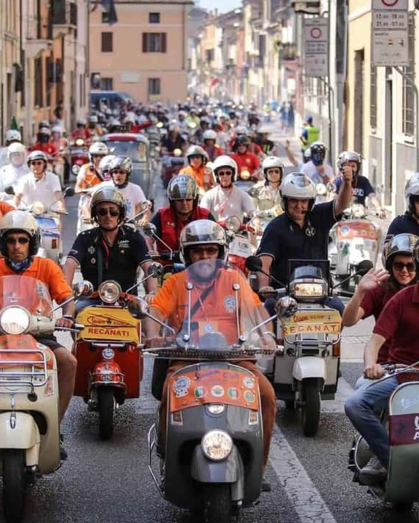
The delivery drivers all drove to the same city district!

Slide 6
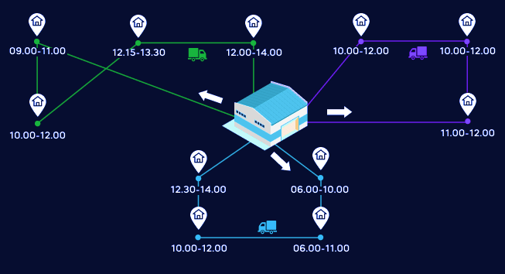

The Vehicle Routing Problem (VRP)
So that the pizza arrives on time…
TSP: optimal route to visit all customers
VRP: optimal set of routes to visit all customers with fleet
Example of the TSP & VRP

Slide 7

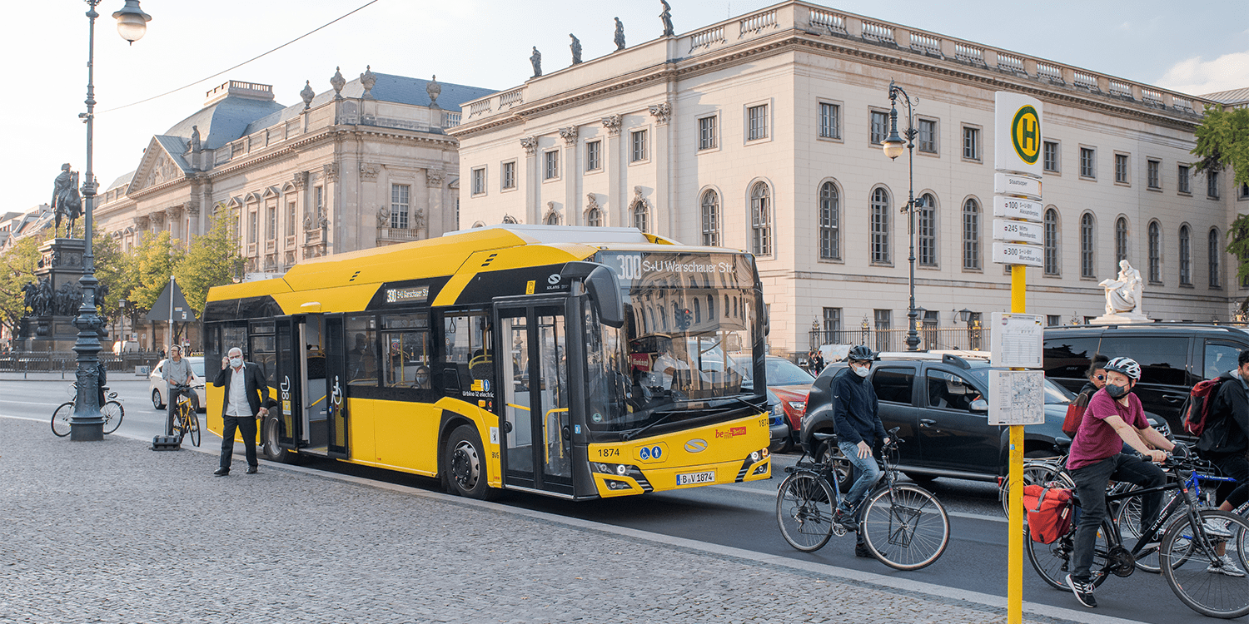
The Vehicle Routing Problem (VRP)
Where else can we use it?
Delivery services
Public transport
Waste collection
Emergency services
Agriculture

Slide 8
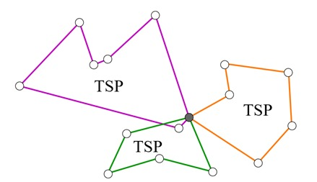
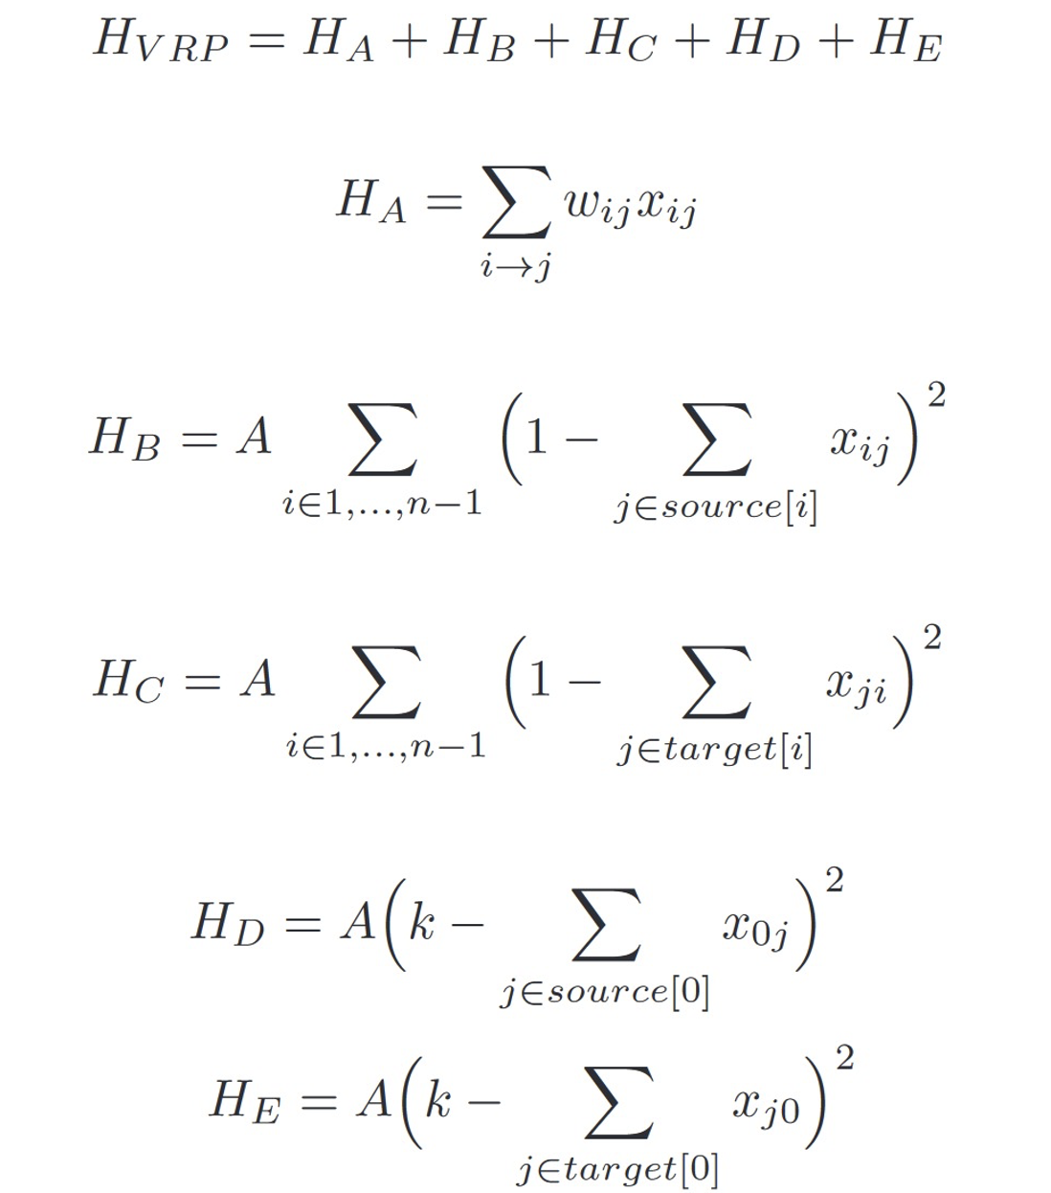
Can we translate this?
And why is the math so hard?!
QUBO
The math gets really difficult…

Slide 9
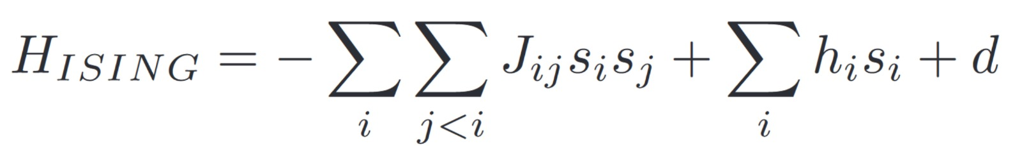
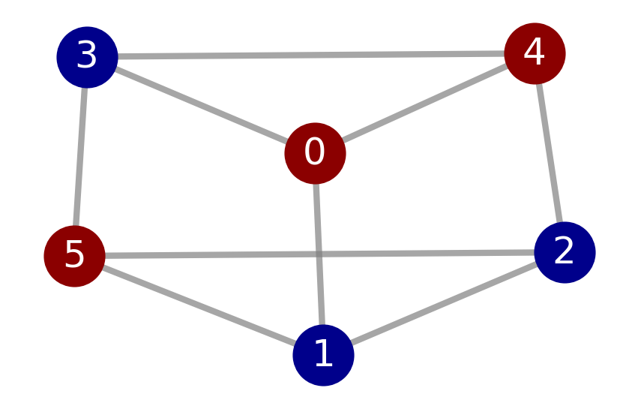
Can we translate this?
And QUBO is really nice!
Represent as MaxCut problem
Ising Hamiltonian
Use QAOA to find ground state
Key idea: Map each node in a graph to a qubit!

Slide 10
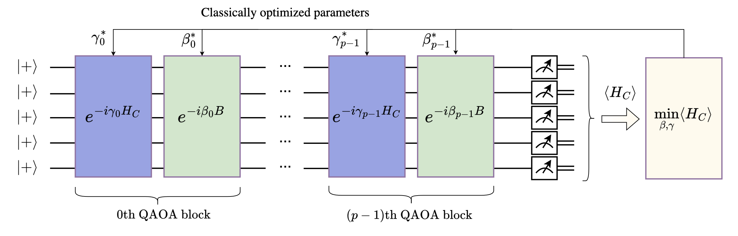
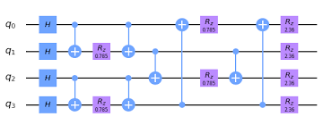
What is QAOA?
And what is the circuit?
2 parameters per layer
p layers

Slide 11
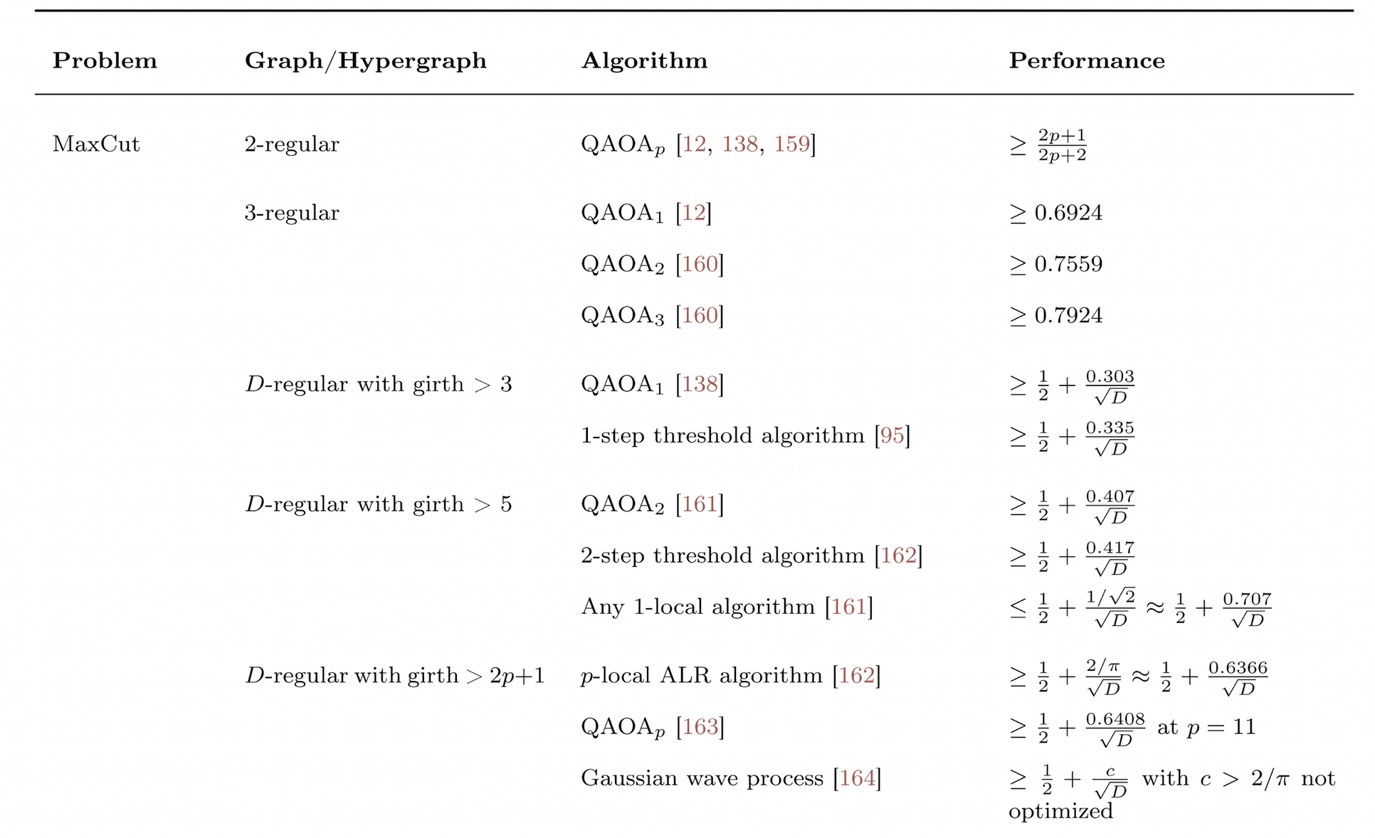
What to analyze with QAOA?
2-layer QAOA for 3-regular graphs!
arXiv:2306.09198

Slide 12
But what is a 3-regular graph?
And why do we need it?
Each node has 3 connections
Cubic graph
3-regular graph with 6 nodes

Slide 13

Can we cut a graph?
Knifes out
Define cut weight $CW=\#edges cut$
Here: $CW=7$
3-regular graph with 6 nodes and highlighted MaxCut

Slide 14
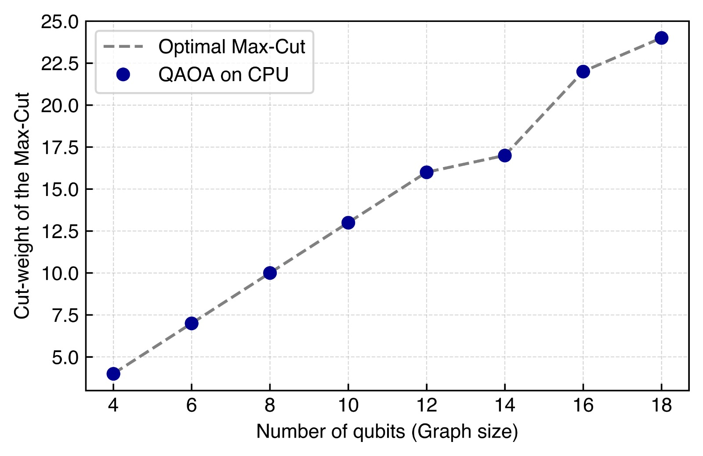

Is QAOA any good?
Compare $CW_{QAOA}$ with $CW_{optimal}$
100 % accuracy!

Slide 15
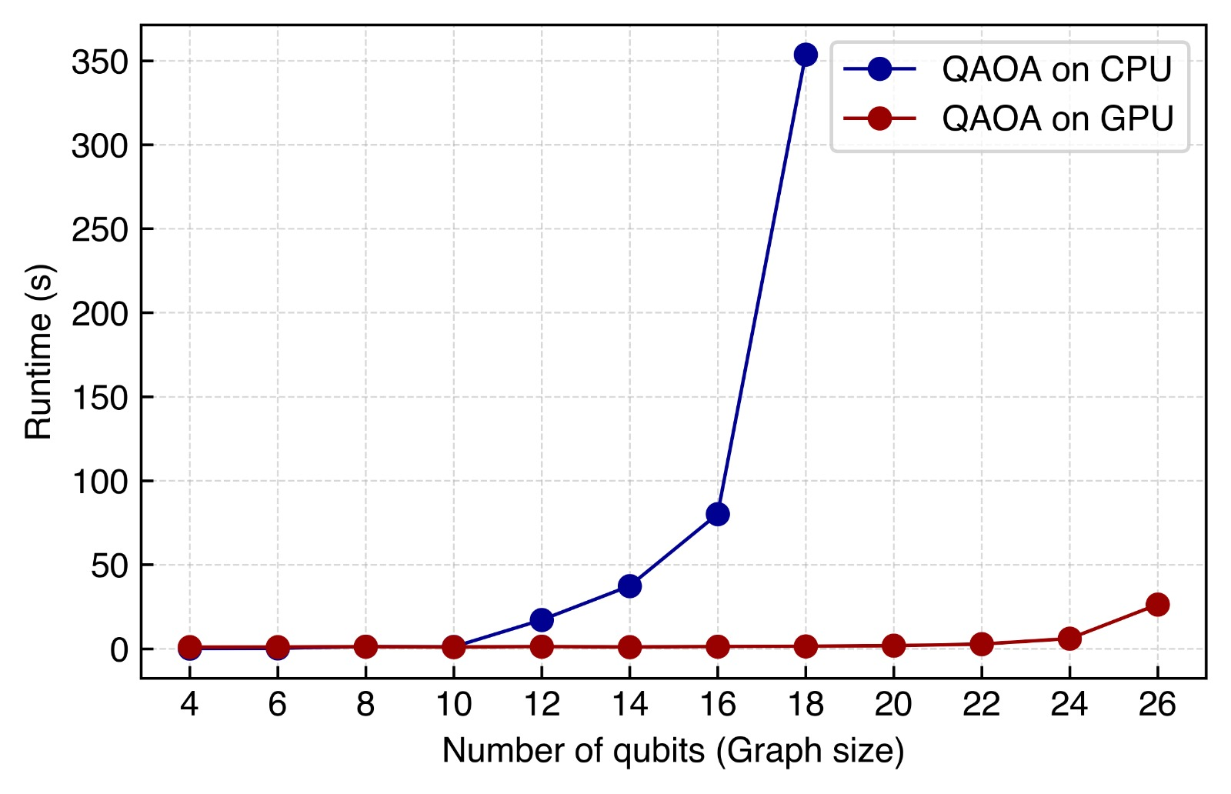
How long does it take?
CPU breaks down for >18 qubits
Enterprise GPU (A100) doesn’t break a sweat
260x
Runtime for increasing qubit number

Slide 16
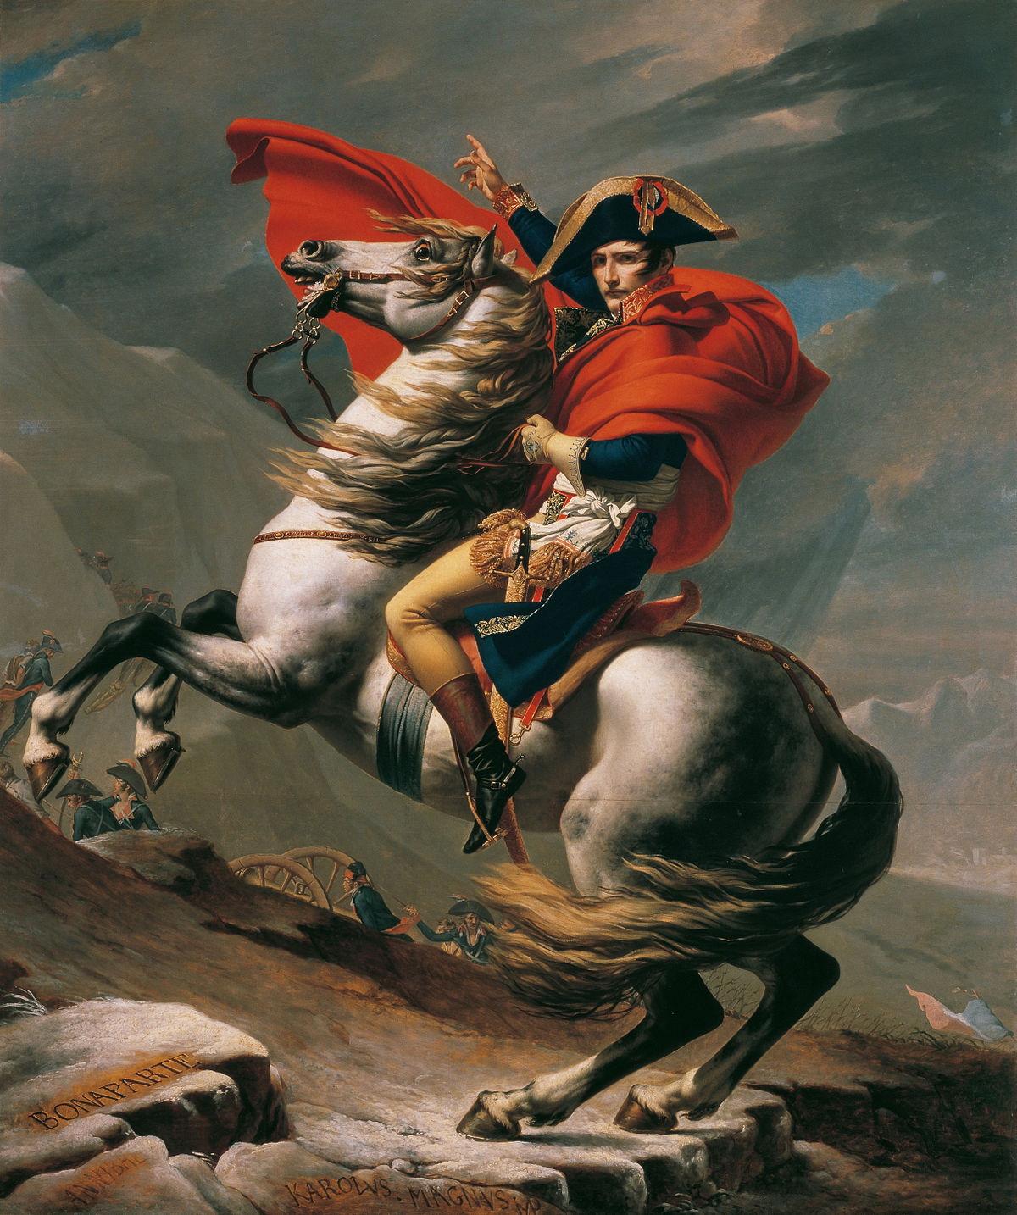
Let’s divide and conquer

Slide 17
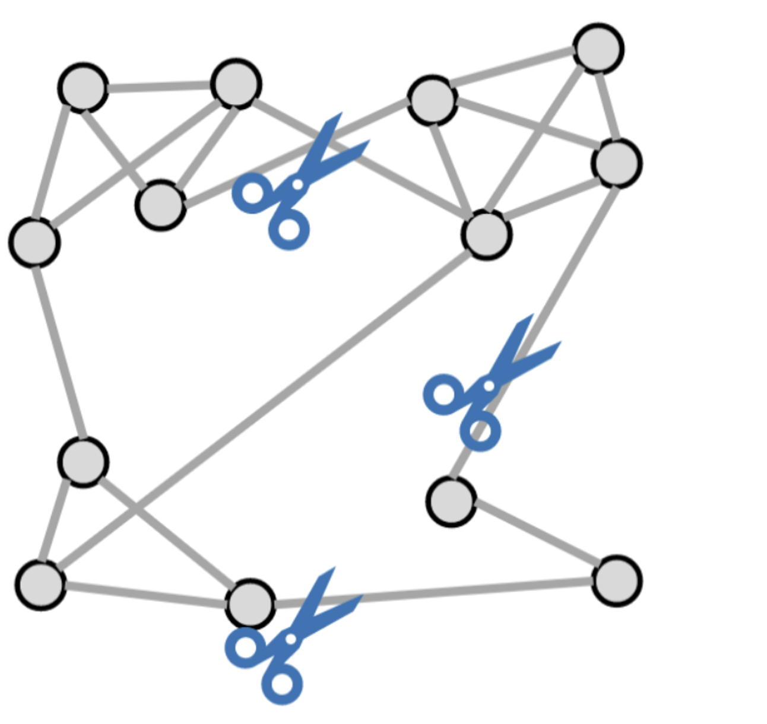
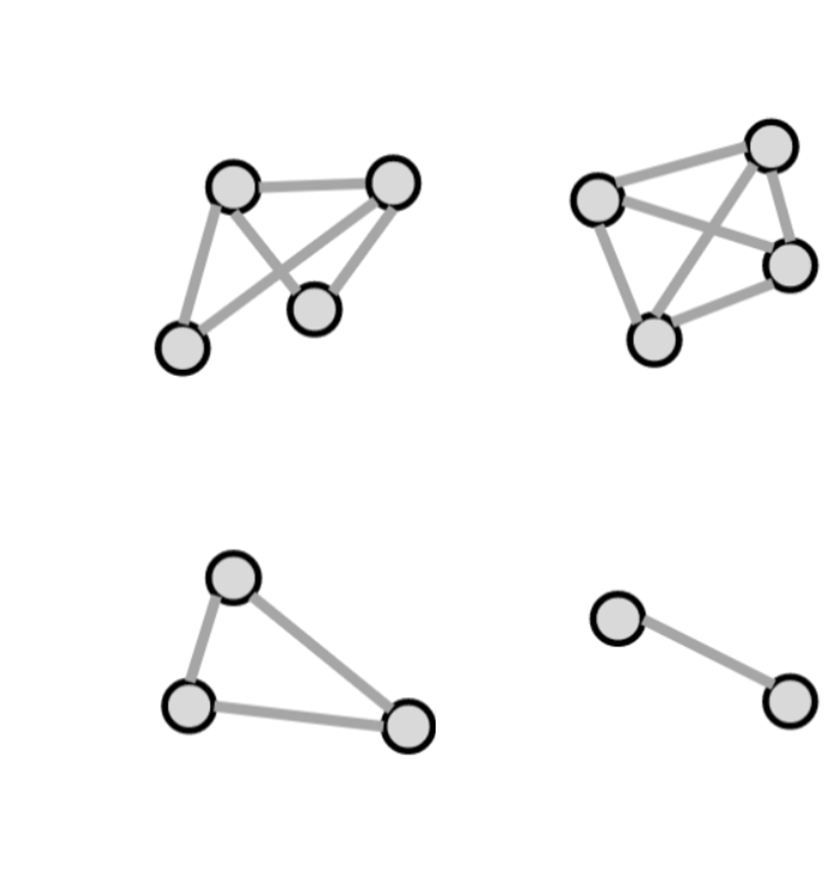
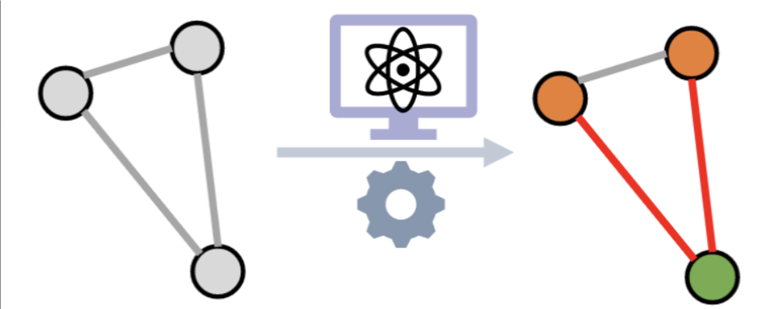
What do we divide?
And what do we conquer?
Divide large graph
Conquer subgraphs individually

Slide 18
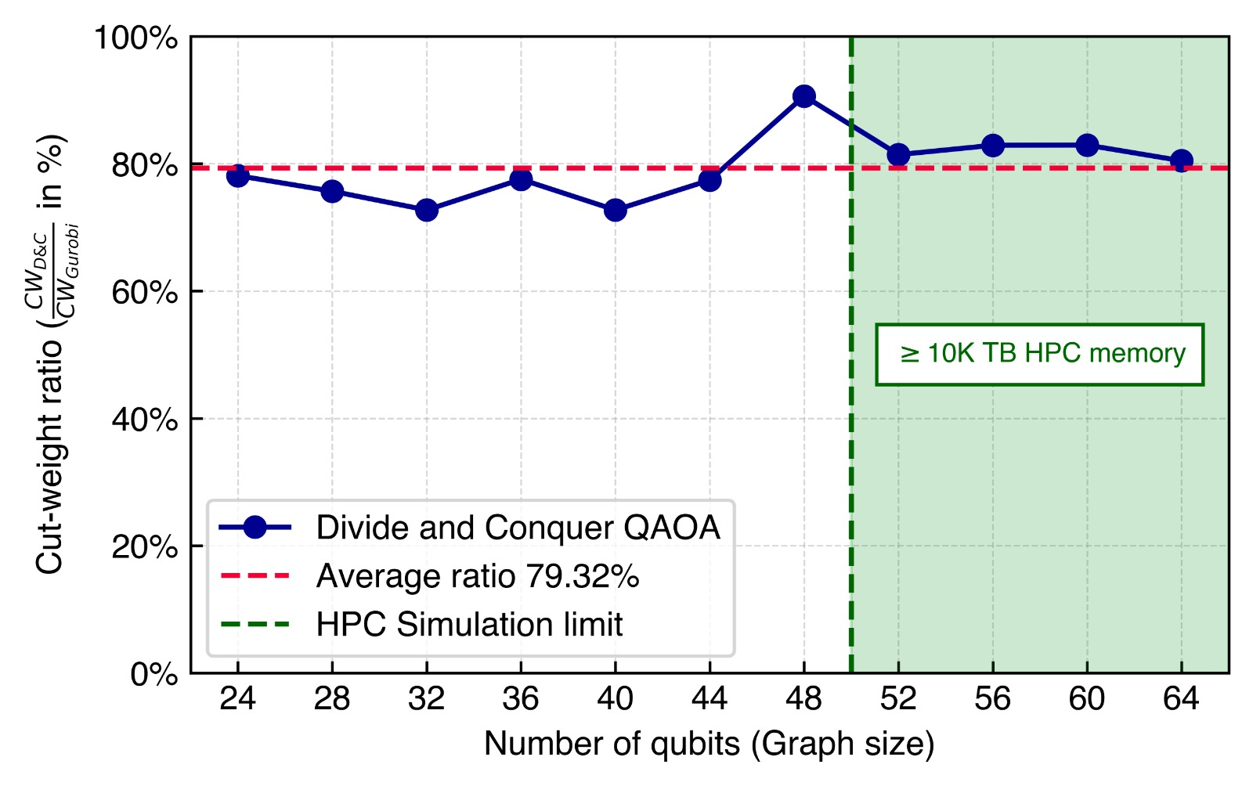

Performance of DAC
Is this any good?
DAC > 80% of optimal cut
HPC memory to store qubits is unfeasible for $n_{qubits}>50$

Slide 19
BACKUP Slides

Slide 20
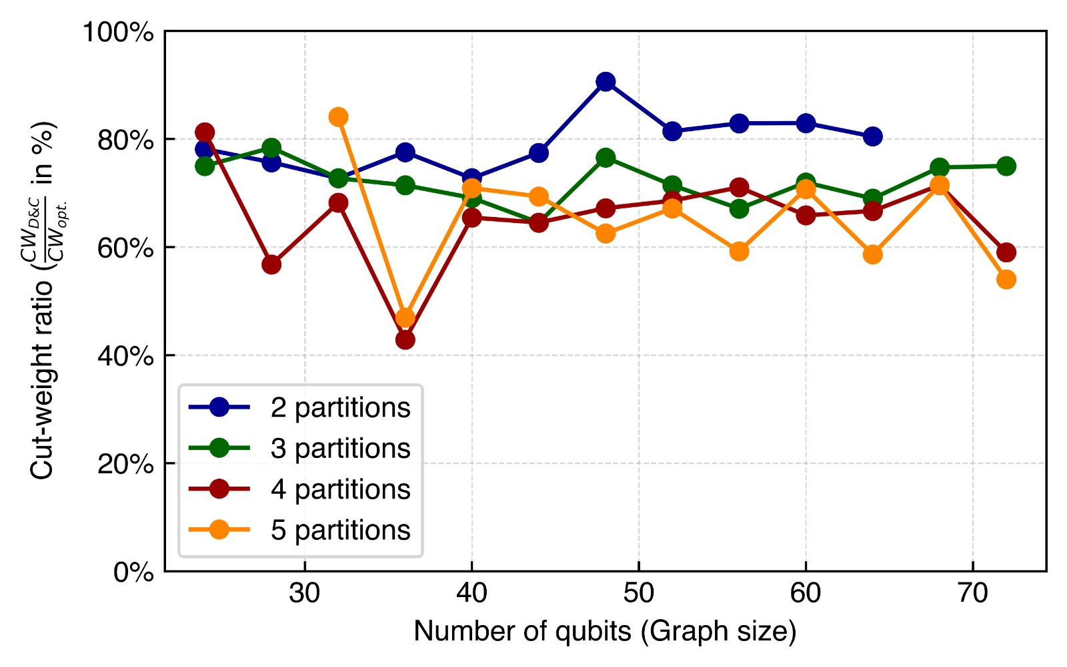
Comparison of different partitions of graphs

